Slide 1

Dr. A. P. J. ABDUL KALAM TECHNICAL UNIVERSITY, LUCKNOW
Presentation on-
A novel approach of 3d surface mapping using lidar technology
Roshani katara M. Tech, ECE,
1900040315002(2019-2021)
Raja Balwant Singh Engineering Technical Campus, Bichpuri, Agra(U.P), India Under the Guidence of Dr. Dushyant Singh
Professor, ECE, Raja Balwant Singh Engineering Technical Campus, Bichpuri, Agra(U.P.), India

Slide 2
Content
Abstract
Introduction
About
Background
Purpose of system
Components used
Block diagram
Flow diagram
Working diagram
Hardware setup
Methology of project
Application
Results
Conculsion
Future scope
Reference

Slide 3
ABSTRACT

Slide 4
INTRODUCTION
Lidar ( light detection and ranging ) . It is an optical remote sensing technology that can measure the distance, other propertie target by ilumanting the target with light , often useing pulse from a laser .
It's advance version of lidar and sonar . The disadvantages of lidar or sona is there low frequency and precision . In contrast of lidar sonar , the new evolving of technology of lidar has very frequencie and precision , especially for short distance measurement .
Lidar technology has several advantage over the pre- existing technology of radar and sonar as it is much more accurate and reliable . Lidar based dem has a precision of 0.1 m along with sufficient horizontal resolution .
In defence there is always need of best information of ground to make combat strategies .

Slide 5
Various methods are used to fulfill such need. Aerial photography is one of the most common method but this method gives only two dimensions information about area .
But 3D mapping can give greater results with 3D coordinate data . 2D image gives information about any object any object but 3D data can give the information of height of the object . In this project we are designing a system that can make 3D mesh from the collected 3D data .
It's is better to get 3D area image of area lidar is important sensor in 3D detection system . It generated prices , high quality , and sometimes even a three - dimensional map of the environment that it scans .
A lidar system consists of a scanner , laser , and sometimes specialists gps receiver as well other elements that are essential for data collection and analysis are optic and photo detector .

Slide 6
ABOUT OF LIDAR TECHNOLOGY
Lidar was invented in the early 1960,shortly after the invention the laser
Its first application came in metrology,where the national center for atmospheric research used to measure cloud and aerosol.
The general public became aware of the accuracy and usefulness of lidar system in 1971 during the Apollo 15 mission. When astronaut used a laser altimeter to map surface of the moon.
1995- first commercial airborne lidar system developed.
Lidar was used in the 1970 by NASA who used this laser romte seeing technology in its development of spacecraft .

Slide 7
Lidar scanner were capable of producing 2000 to 25000 pulses per second and were mainly being used for topographic mapping of the earth's surface .
lidat instrument of lidar system 1. Laser 2. Detector
And most of the lidar system works on the the
Principle of the time of light
While the rider system can not works in such harsh environments .

Slide 8
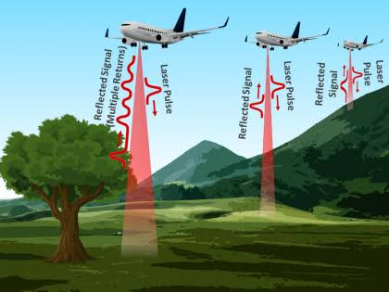

Slide 9
Components of lidar system
1.Photodetector and electronic receiver
2.scanner and optices.
4.IMu
3. GPA
5.aircraf

Slide 10
PURPOSE OF SYSTEM
Developing a lidar 3D surface navigation and modelling system
Testing of various algorithms to processing the 3D data
Processing data and convert it into 3D coordinate point data that can be projected the 3D image of the field
Applying resolution implementation and cohesion techniques .

Slide 11
Components used
16×2 LCD
Arduino mega 2560
microchip atmega 2560
Lidar module
Lm 2596
Servo motor
Ultrasonic module
Wemos

Slide 12
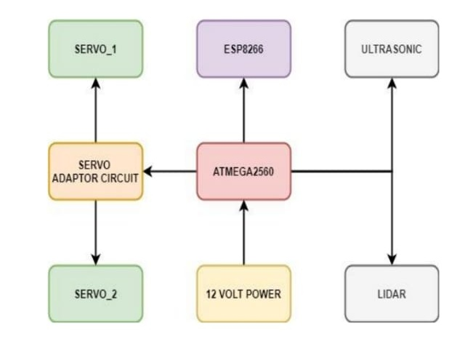

Slide 13
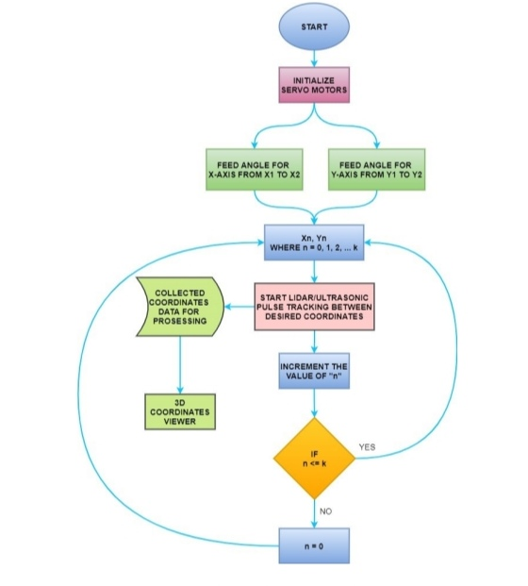
Flow diagram of lidar

Slide 14
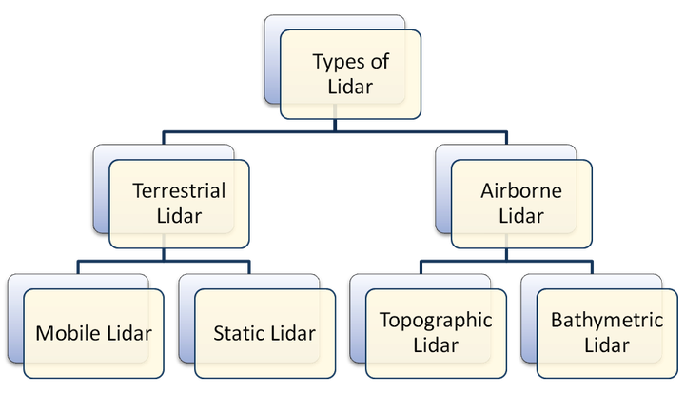
Types of lidar

Slide 15
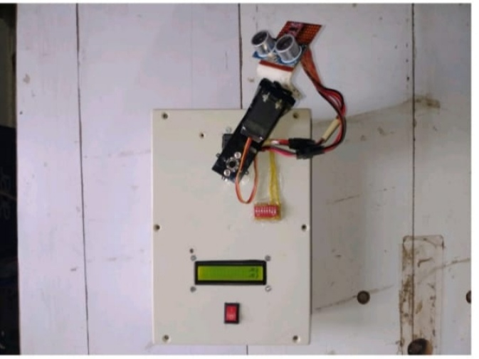
Hardware setup :-

Slide 16


Slide 17
Methodology
Light detection and ranging is a technology similar to radar using laser instead of radio waves . Lidar principal is pretty easy to understand
It emits a laser pulse on a surface
Catches the reflected laser back to the lidar pulse source with
Measure the time laser travelled
Calculate the distance from sources with the formula “ distance = ( speed of light x time elapsed ) / 2
This process is repeated a million times by lidar instrument and ends up producing a complex map of the surveyed area known as a 3d point cloud .

Slide 18
Applications
Military
Self driving car
Agriculture
Atmosphere remote sensing and meterold
Astronomy
Land management
Climate change
Robitics

Slide 19
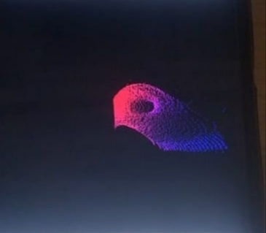
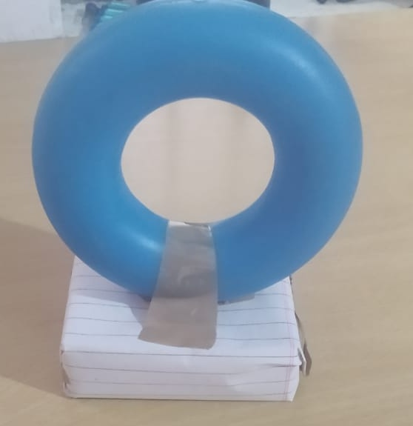
Result

Slide 20
Conclusion
Lidar has the superior performance than tha pre- existing radar and sonar technology due to its high accuracy and resolution . 3D mapping is required particularly to build the map of any given surrounding . 3D mapping using lidar is very accurate, reliable and cost effective . Lidar is mounted on a fingered v servo motor which maps the given environment in 3D.

Slide 21
Future scope : -
This device can be made compact
- range can be varied about 20 cm to 200 m
- it can be prepared for fast processing fast processing cm be done if multiple micro controller is used wife it
Weight can be reduced

Slide 22
Reference :-
1.Simple and cost-effective 3 - dimensional(3D) mapping of internal structures Light Detection and Ranging (LiDAR), Authors: VandanaV , Yashaswini S , Vidya B, PaperID: IJERTCONV6IS13090 , Volume & Issue : NCESC –2018 (Volume6 Issue13) ,Published (FirstOnline) : 24-04-2018 ,ISSN (Online) : 2278-0181 , Publisher Name :IJERT . https://www.ijert.org/3d-mapping-using-lidar
. 2.Airborne LiDAR Technology :A Review of Data Collection and Processing Systems by Bharat Lohani Sudhasheelgosh ,Proceeding of thenational academy of sciences ,indiasectionA :Physical Sciences 87,567-579(2017). https://link.springer.com/article /10.1007%2Fs40010-017-0435-9
. 3.Integration of light detection and ranging technology with photogrammetryin highway location and design by David Veneziano ,Riginald, solueyrette ,Shauna Hallmark, Volume 1836, first published January 1, 2003. https://journals.sagepub.com /doi/ 10.3141/1836-01 4.W.Shen ,J.Zhangand F.Yuan,"Anewalgorithm of buildingboundary extraction basedon LIDAR data ,"201119th International Conferenceon Geoinformatics, Shanghai, 2011, pp.1-4.doi:10.1109 /GeoInformatics.2011.5981049.
4.Monocular Camera Localization in Prior LiDAR Maps with 2D-3D Line Correspondences by HuaiYu and WeikunZhen and Wen YangandJi Zhangand Sebastian Scherer, Proceedings of(IROS)IEEE/RSJ International Conferenceon

Slide 23
reference contd..... : -
Intelligent Robots and Systems, published on October 2020. https://www.ri.cmu.edu /publications/ monocular - camera-localization – in – prior -lidar- maps-with-2d-3d-line-correspondences -2/.
4. Sebastian Thrun ,Wolfram Burgard ,Dieter Fox ,A Real- Time Algorithm for Mobile. Robot Mapping With Applications to Multi-Robot and 3D Mapping IEEE.
International Conferenceon Robotics and Automation ,SanFrancisco ,April 2000. 5 .J.Borenstein, H.R.Everett ,Mobile Robot Positioning :Sensors and Techniques.

